Slide 1
Stryków and its nearby area

Slide 2
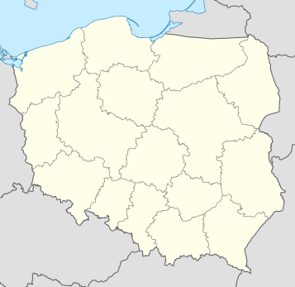


Stryków is a small town in central Poland located in Lodz province, in Zgierz county. It has around 3,400 inhabitants.
Stryków
Flag
Coat of arms

Slide 3
A few words about our school ;)

Slide 4
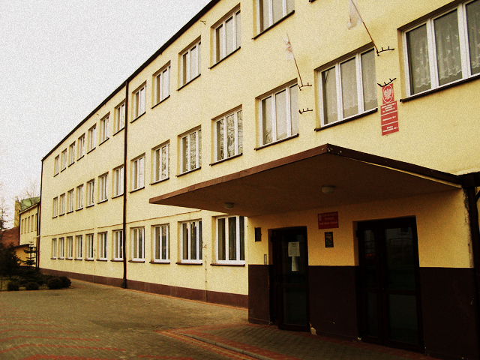
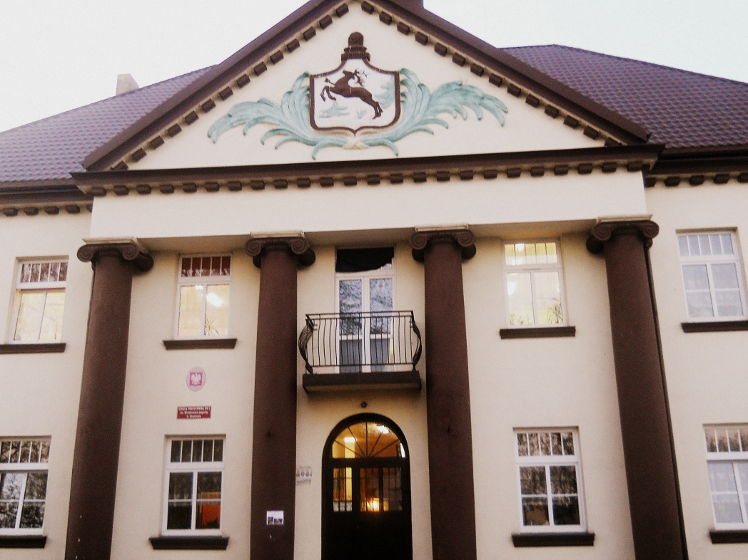
There are two primary schools in Stryków
Our school
Primary school no 2
Primary school no 1

Slide 5
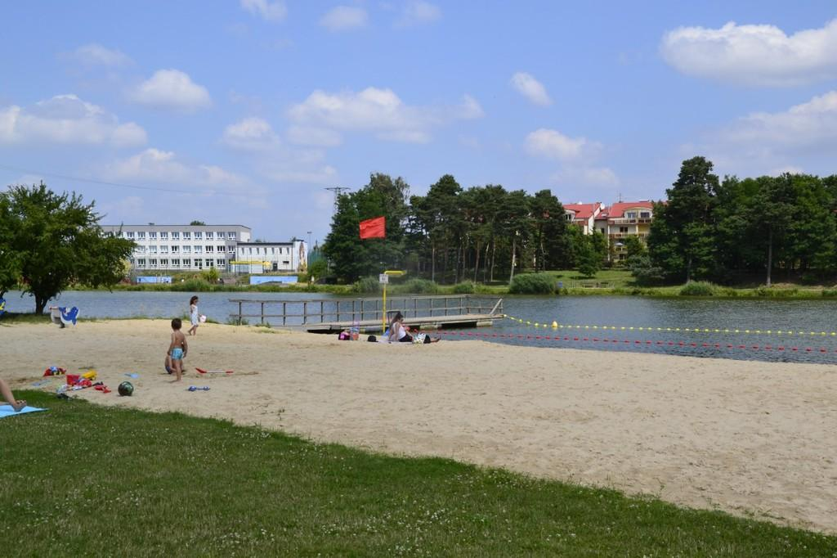
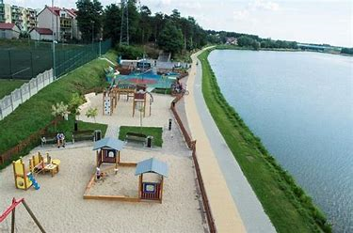
Our school is located by the artificial lake with an area of ​​9 hectares. It’s a really cosy place for fishing, having picnics, go kayaking or water bikes.
Our school ;)

Slide 6
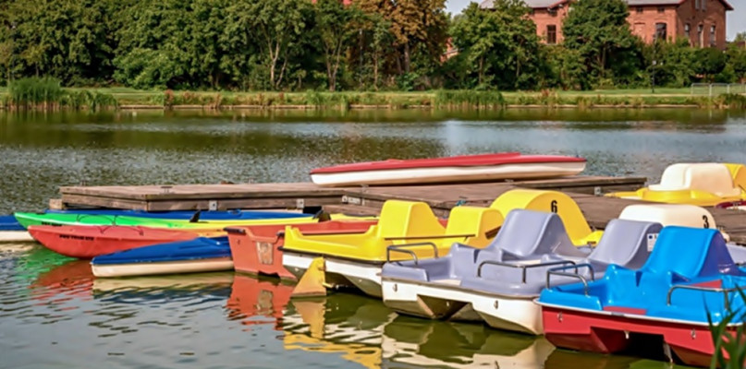
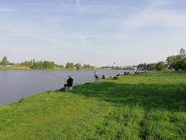
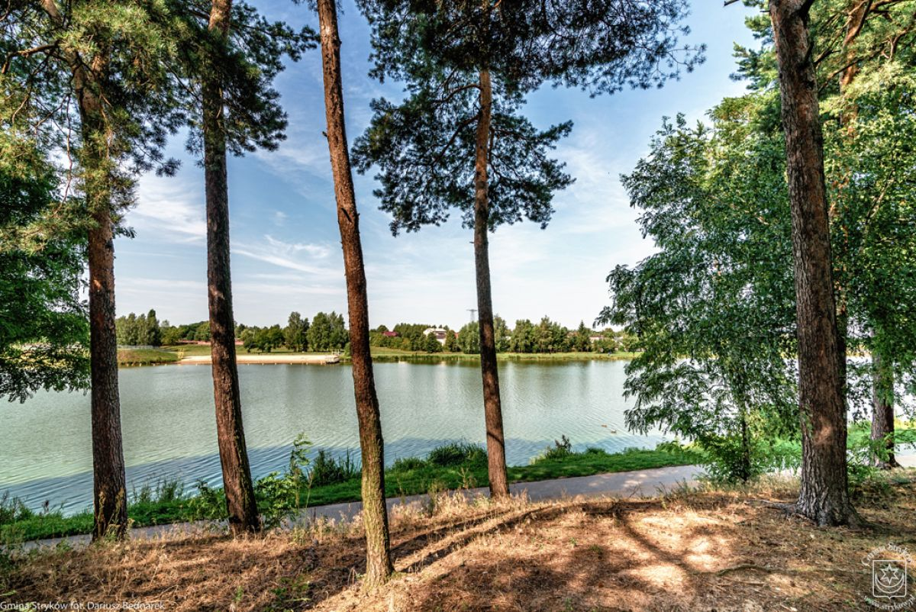
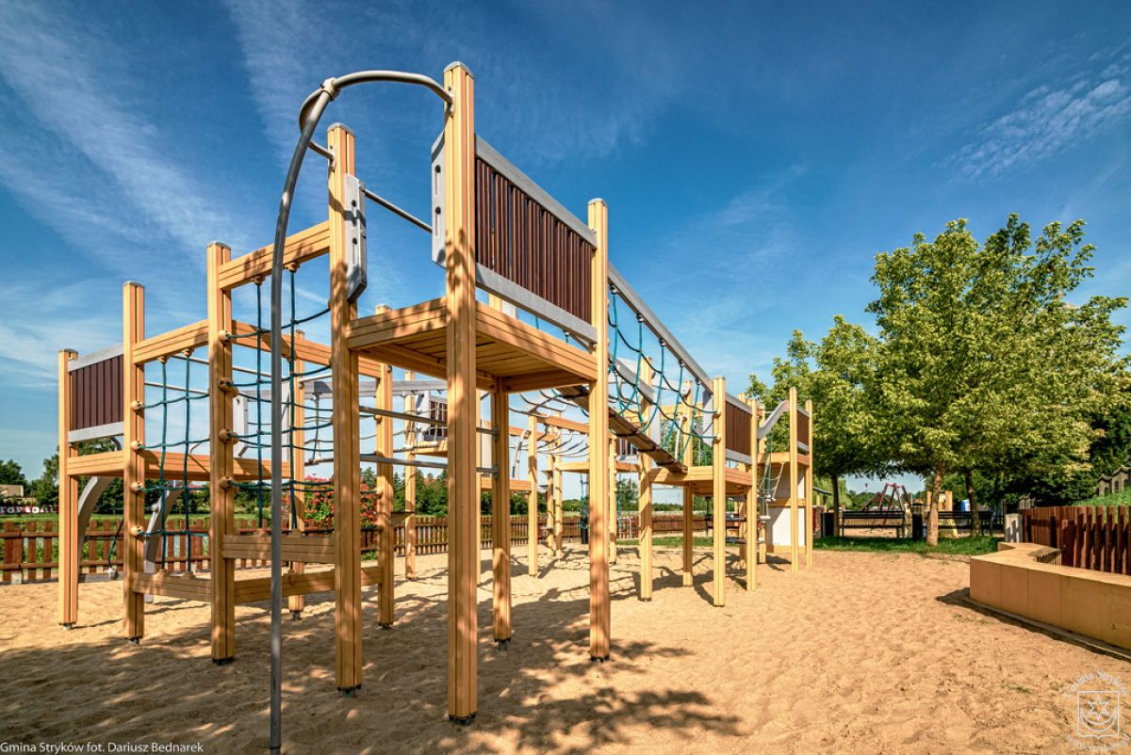

Slide 7
…the view from our school windows is simply amazing…

Slide 8
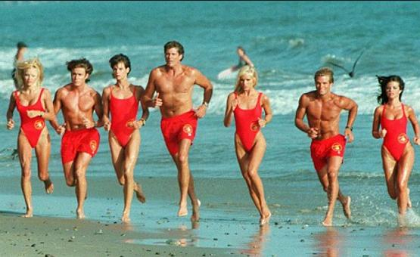

Slide 9
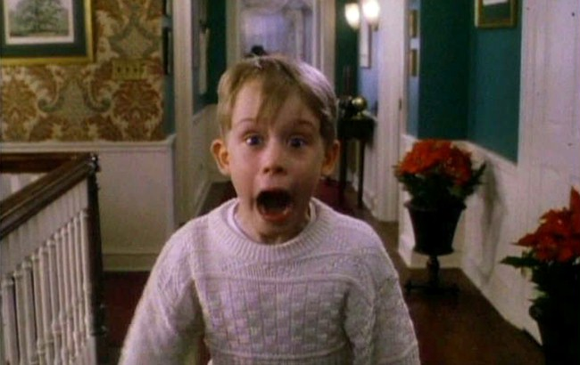

Slide 10
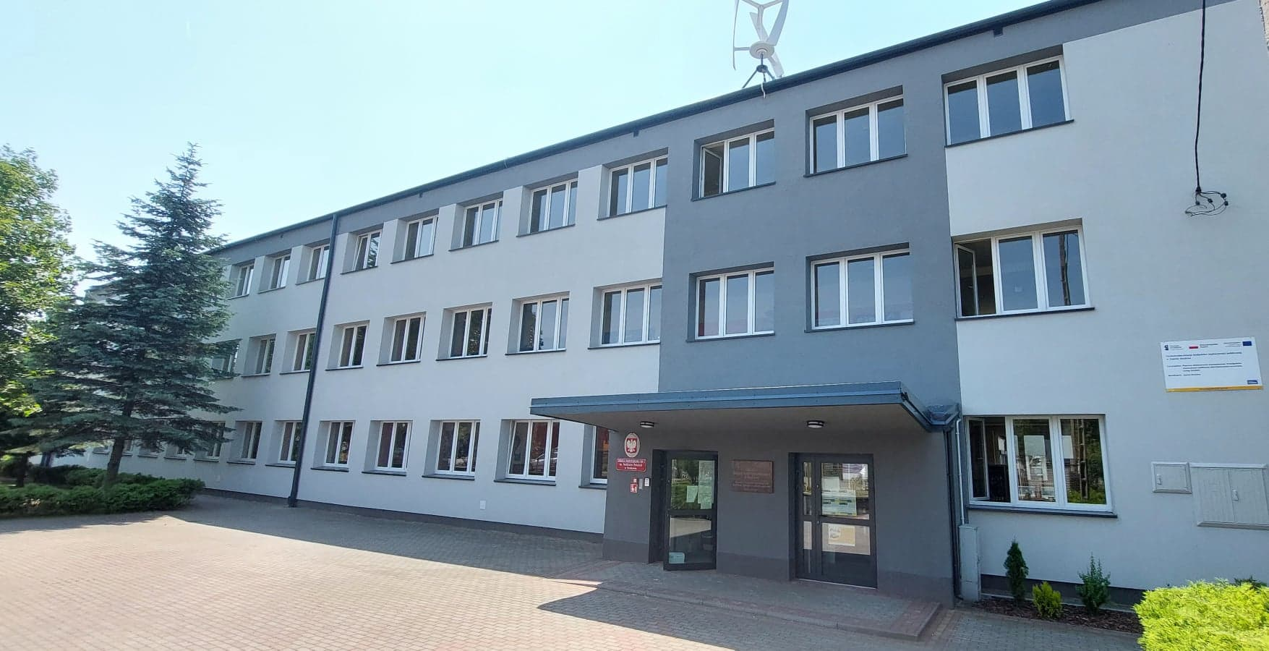
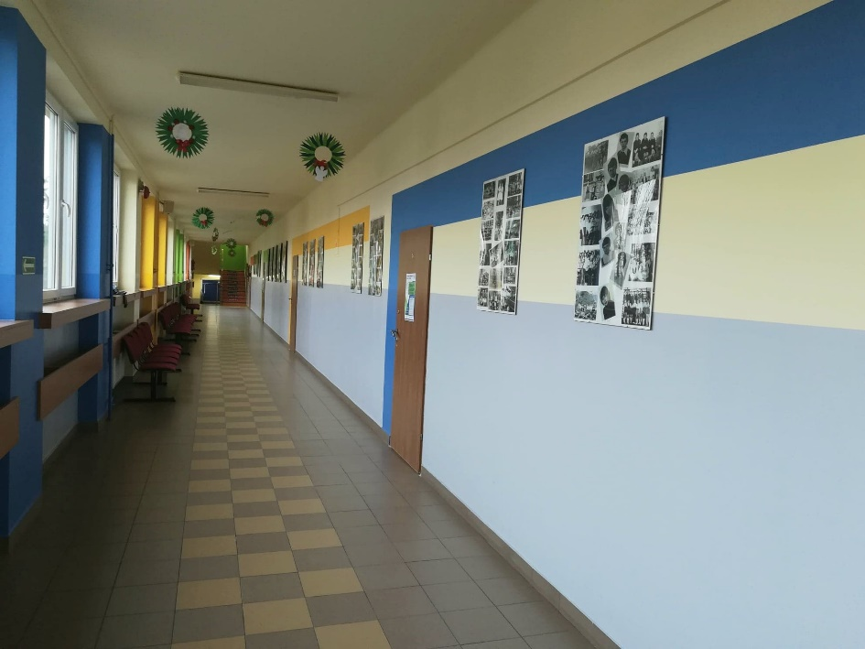
There are about 40 teachers and 420 students aged from 7 to 15.

Slide 11
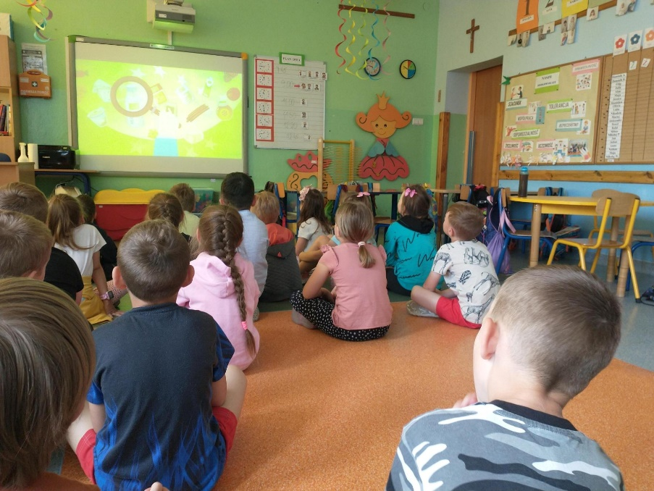
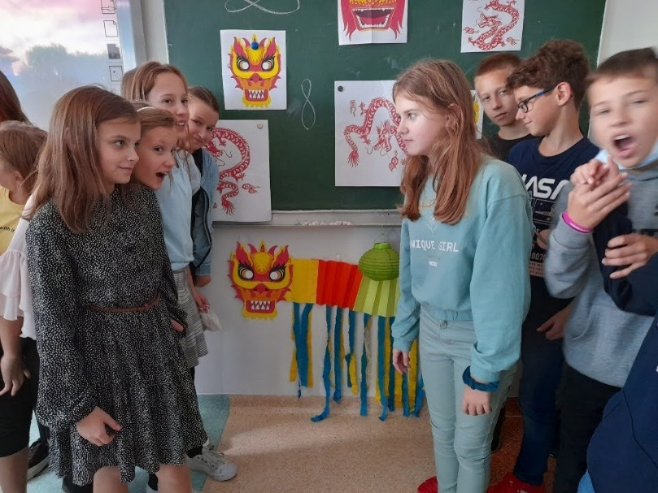
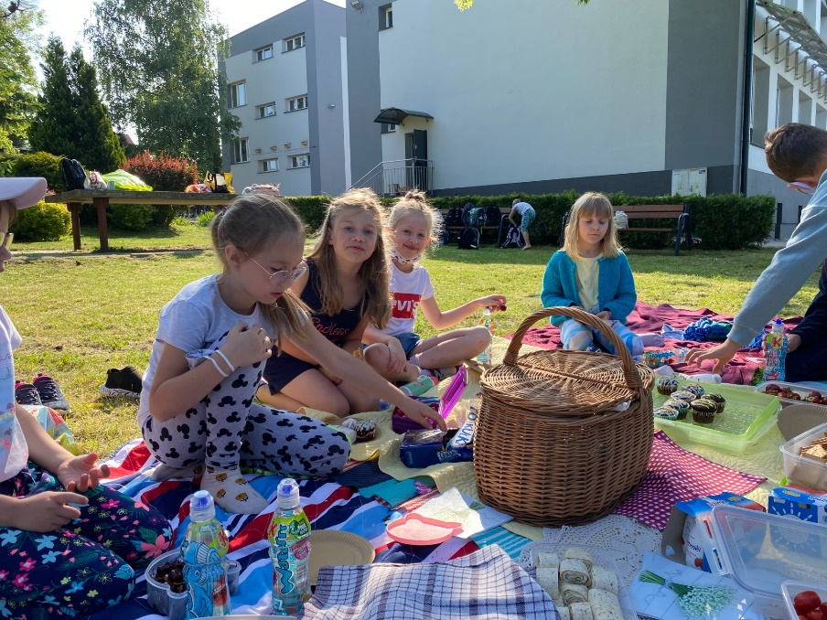
Different school activities

Slide 12
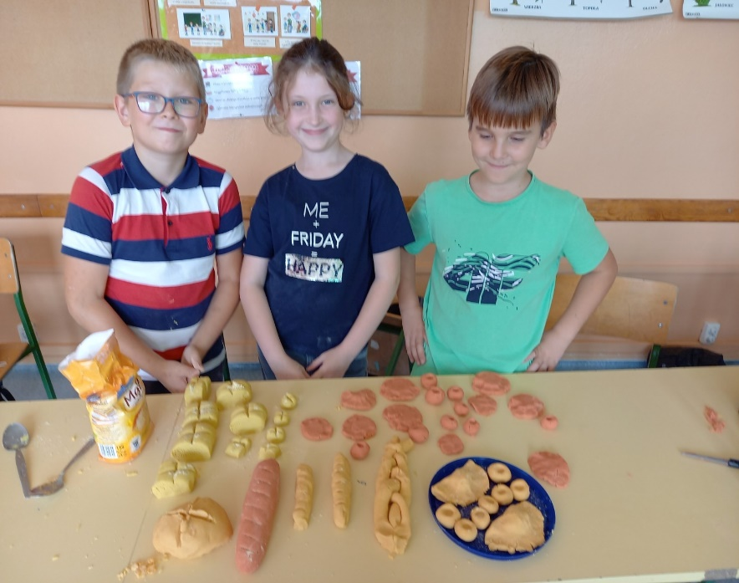
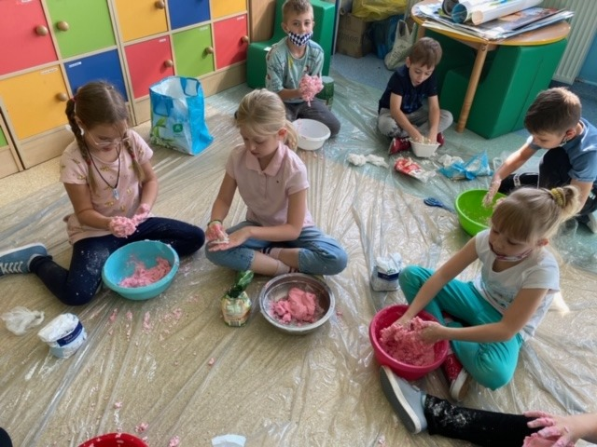
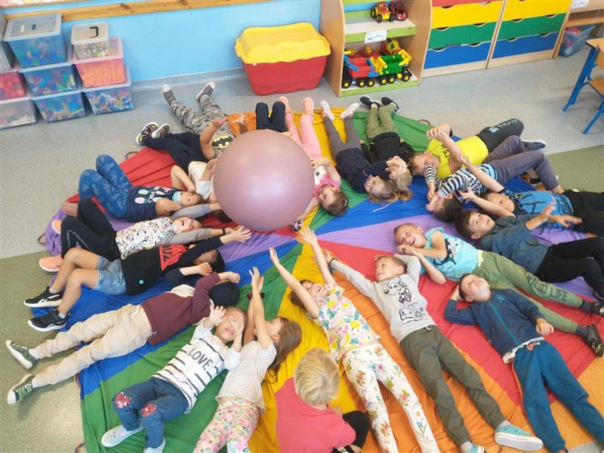

Slide 14
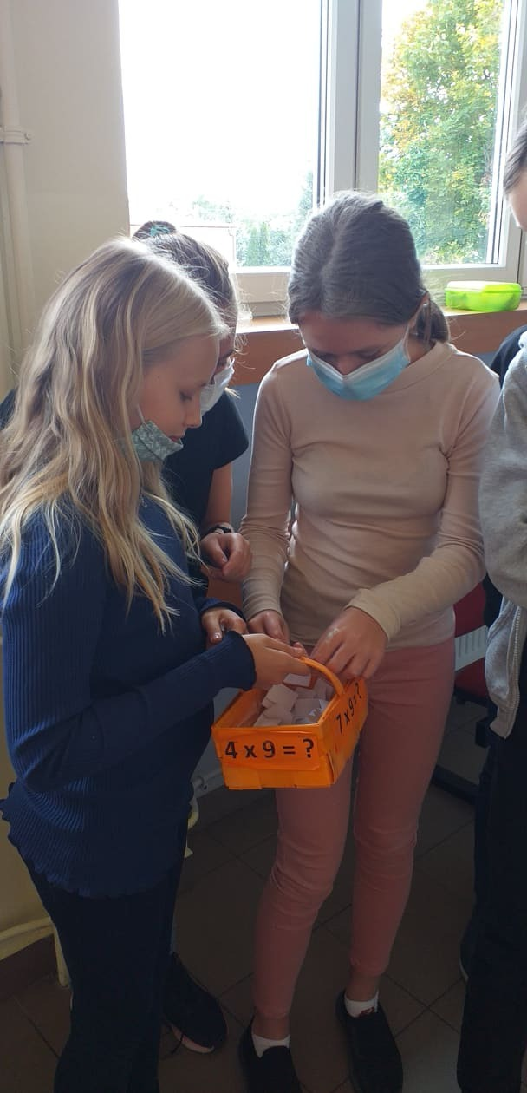

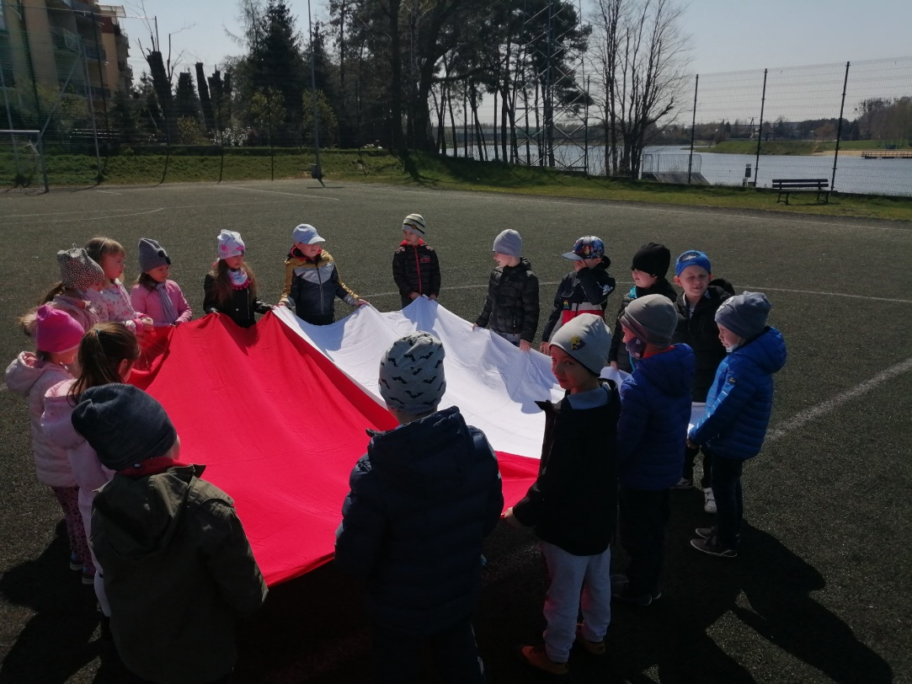

Slide 15
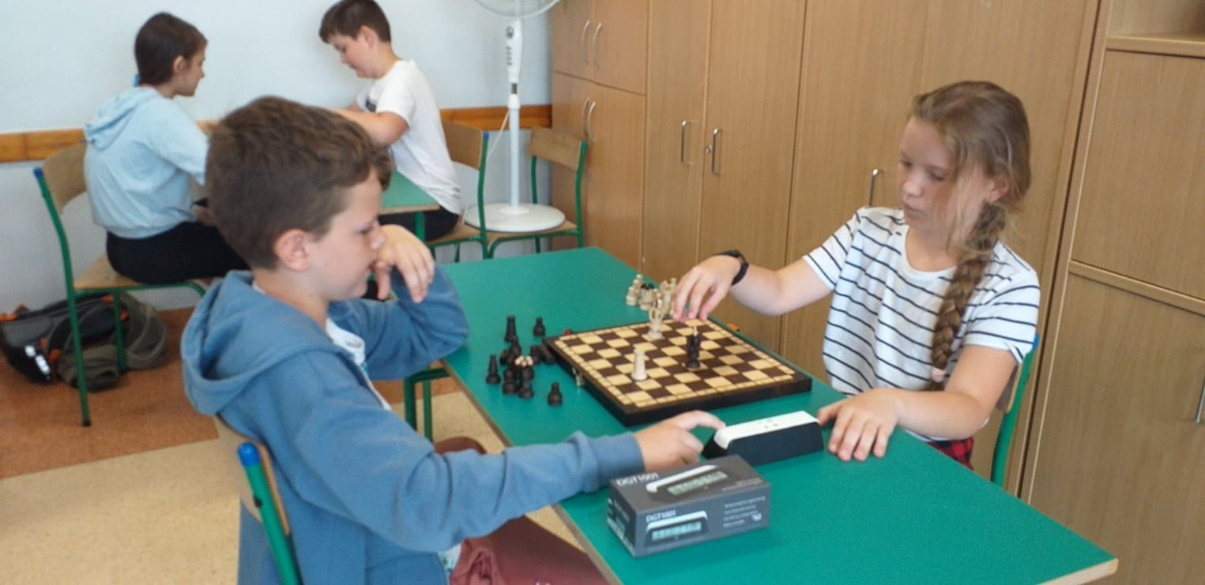
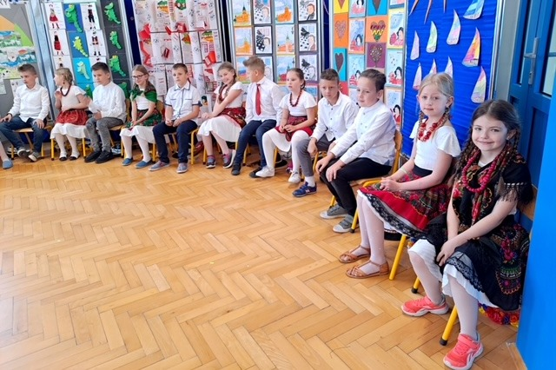
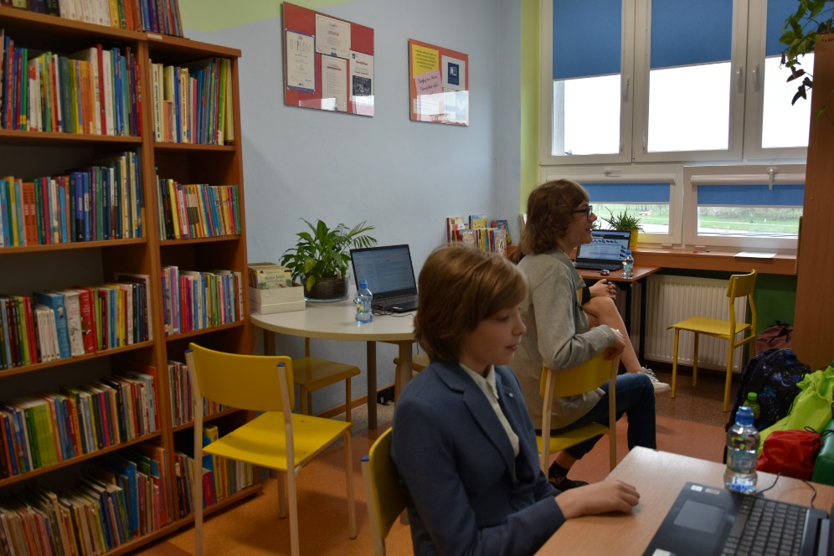

Slide 16
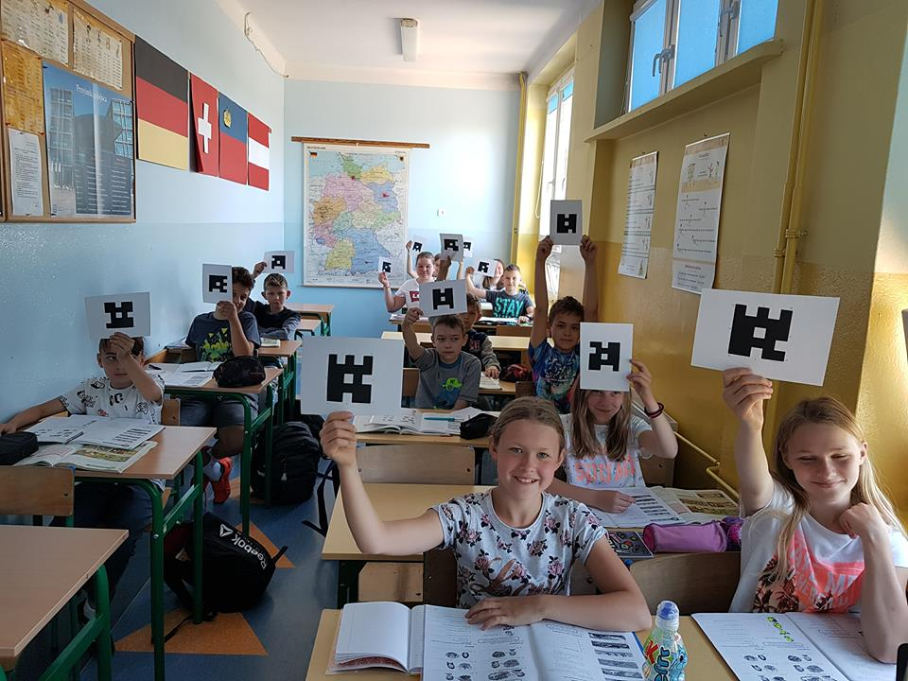
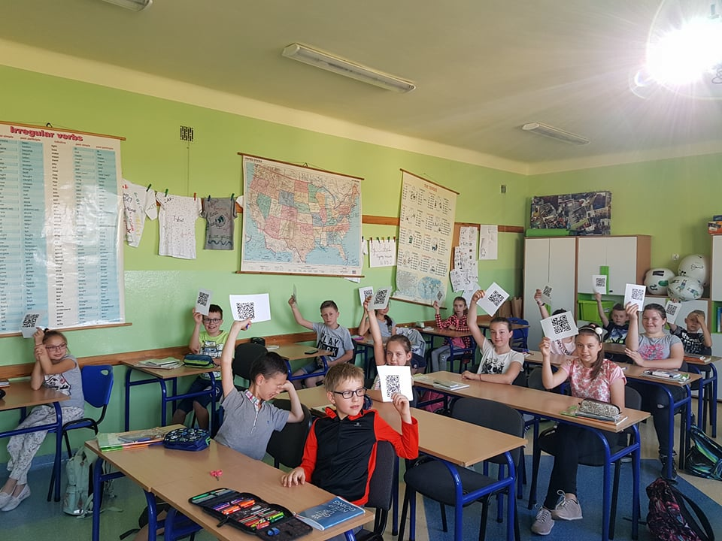
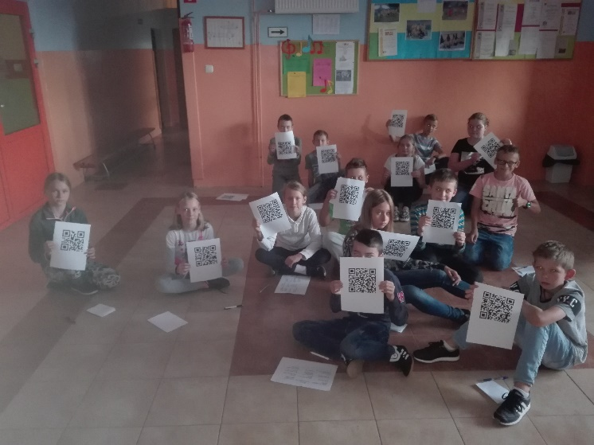
Some English classes with the use of tablets, smartphones and apps

Slide 17
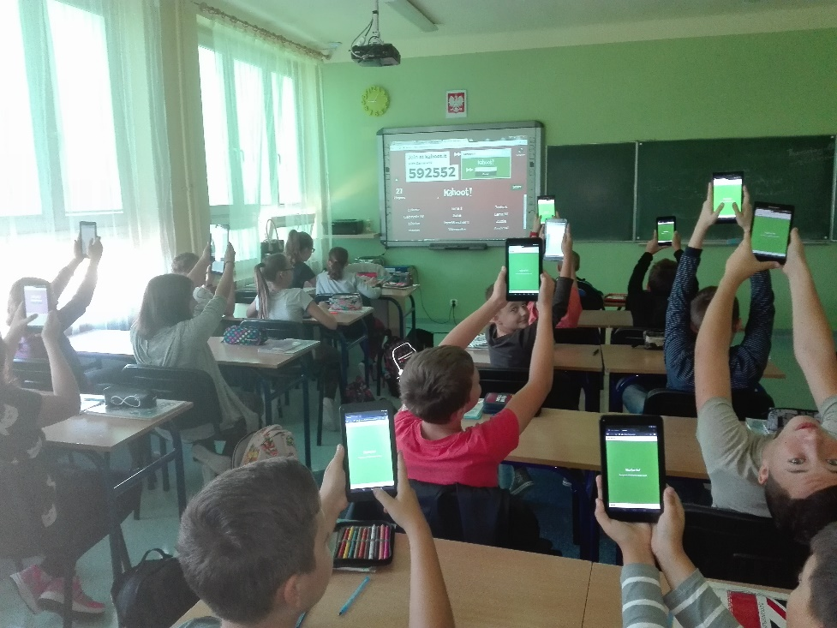
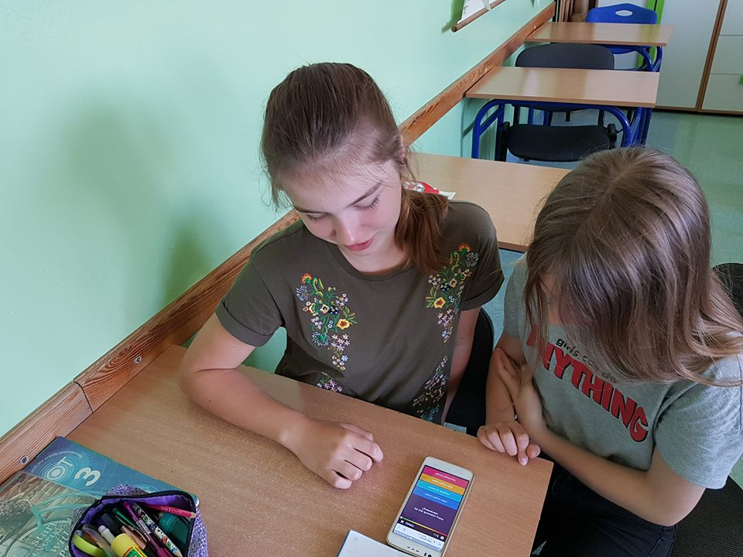
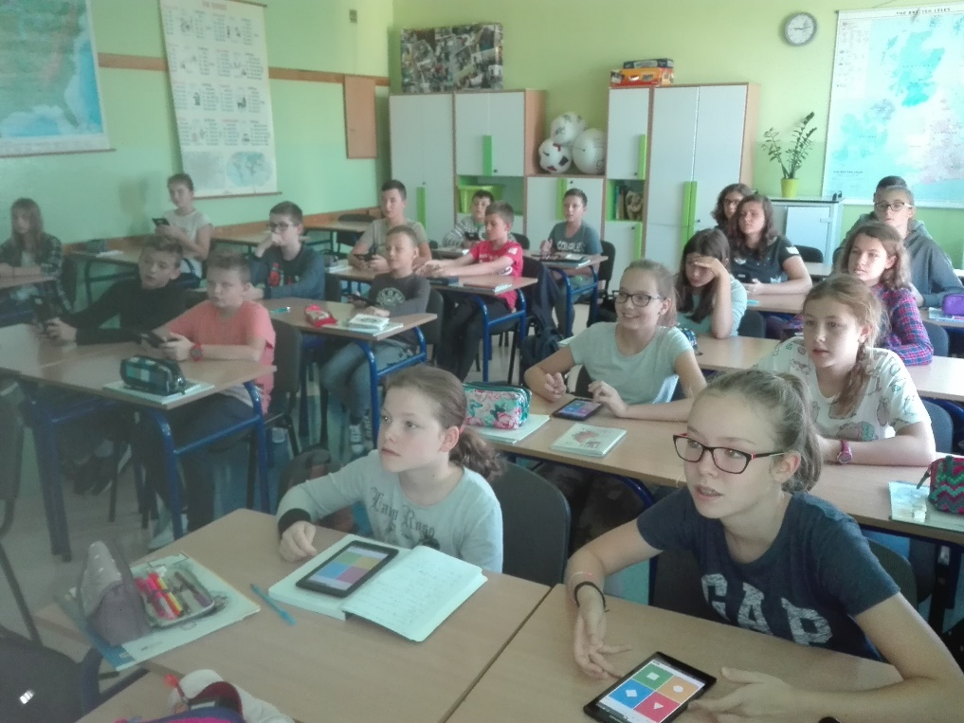

Slide 18
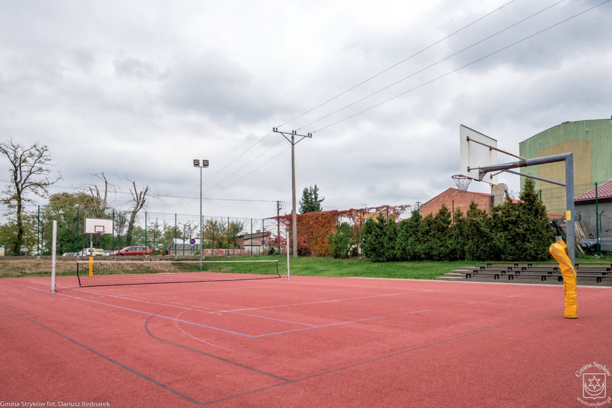
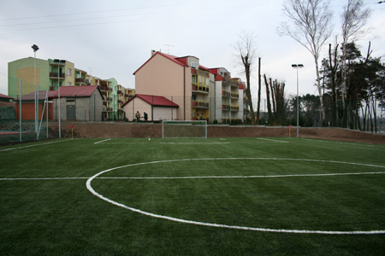
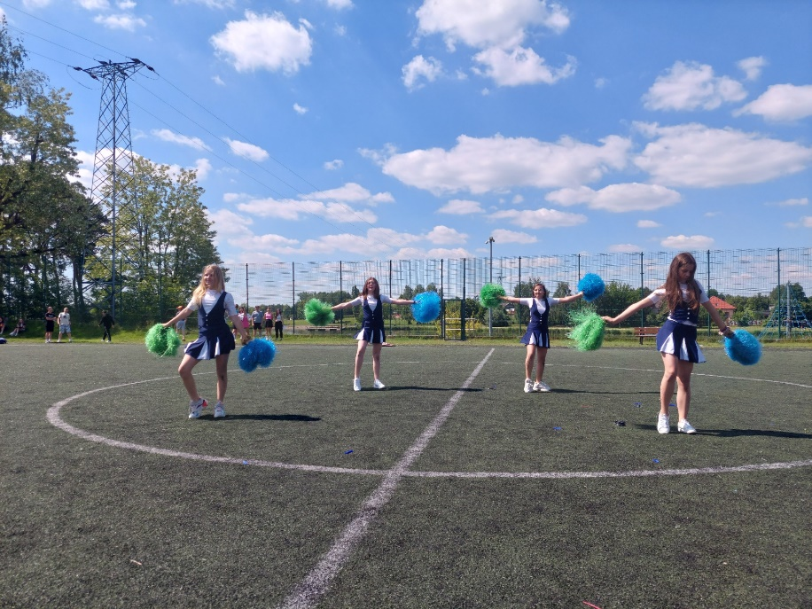
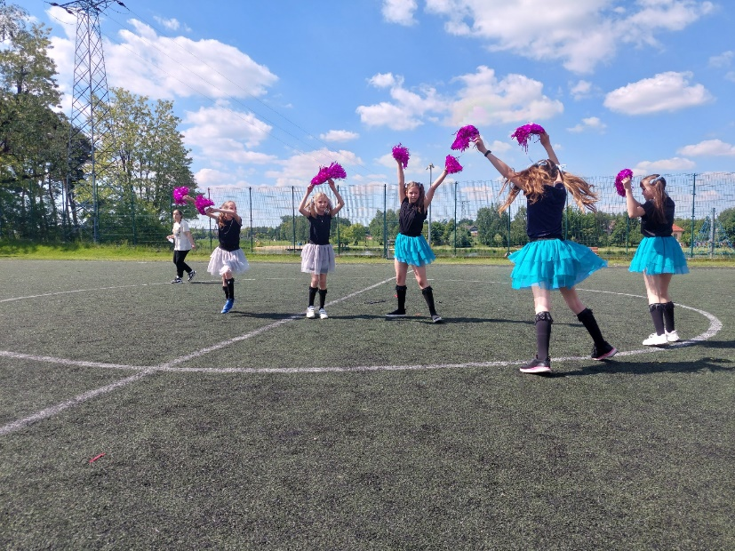
School playground „Orlik”

Slide 19
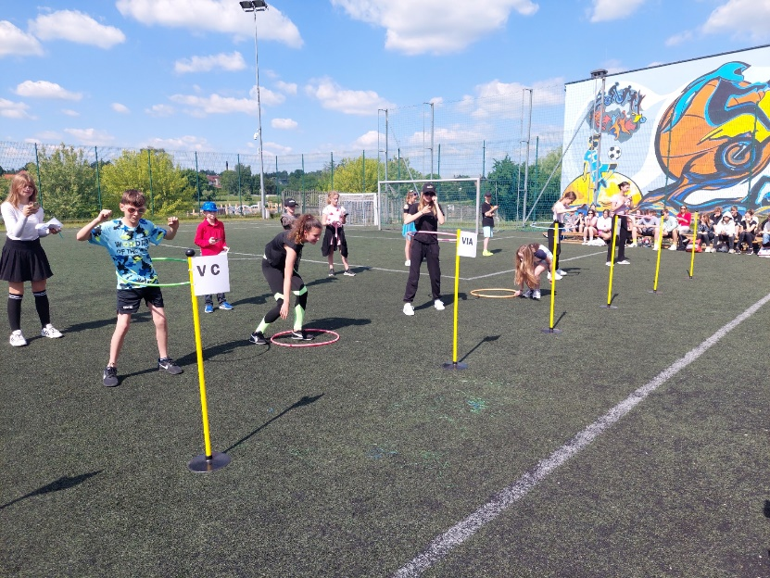
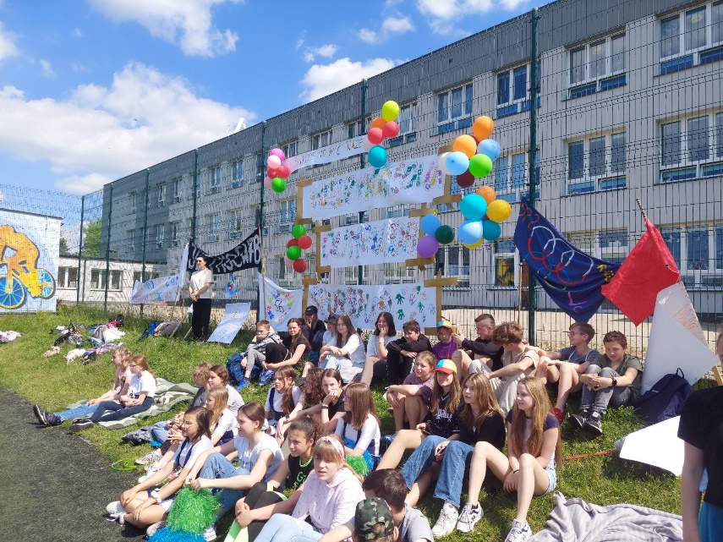
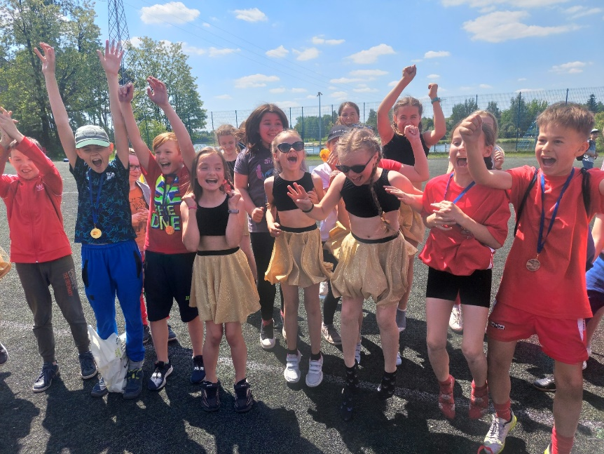
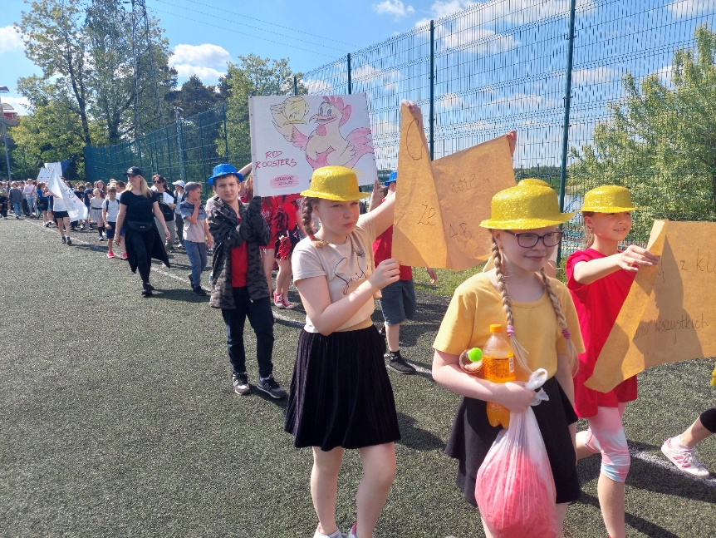
Children’s Day Celebration- School Olympic Games

Slide 20
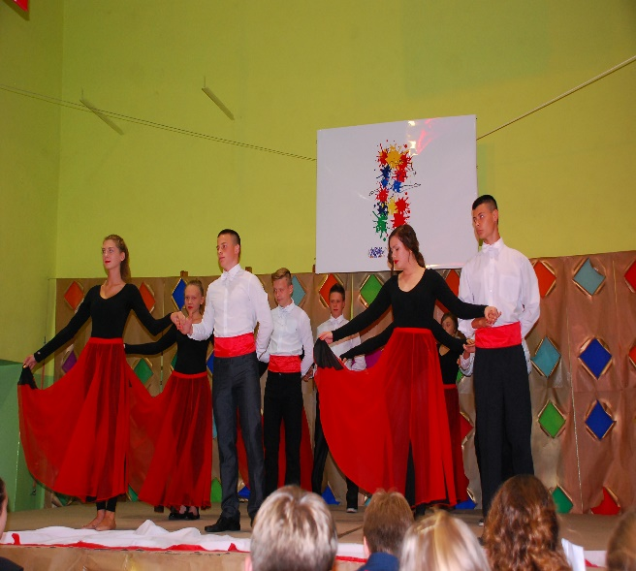
Comenius projects
2009-2011
Four shades of four seasons of the year
(France, Sweden, Turkey, Poland)
2013-2015
MADE: Music Advantages of Diversity of Europe (France, Greece, Italy, Poland, Romania, Spain)

Slide 21
eTwinning projects
August 2016
A big creative European family
October 2016
Our regional cuisine on a European scene
August 2017
Peace and Freedom

Slide 22
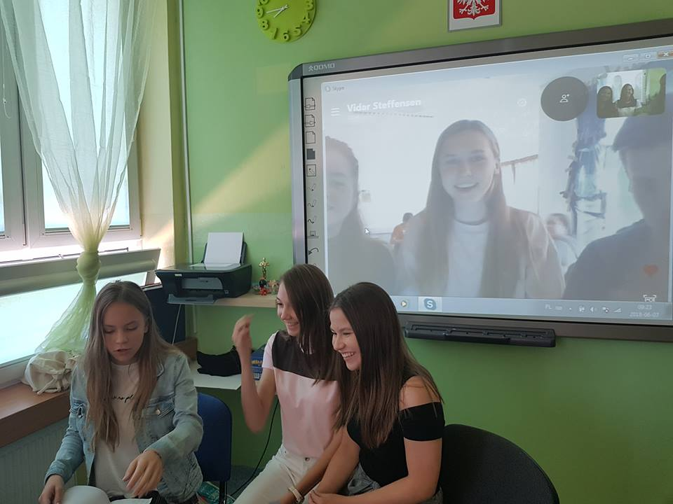
A video chat with Norway (eTwinning)

Slide 23
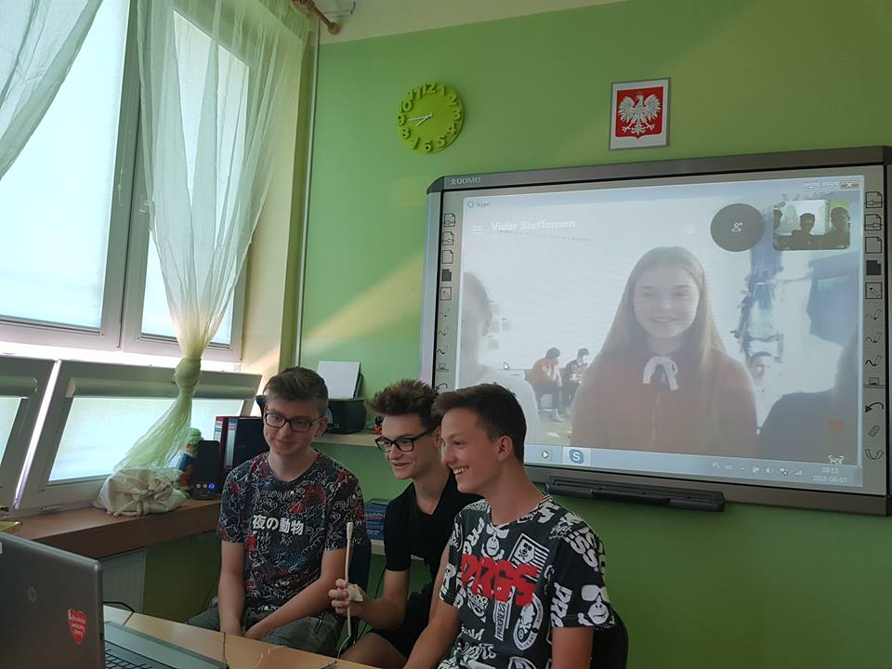

Slide 24
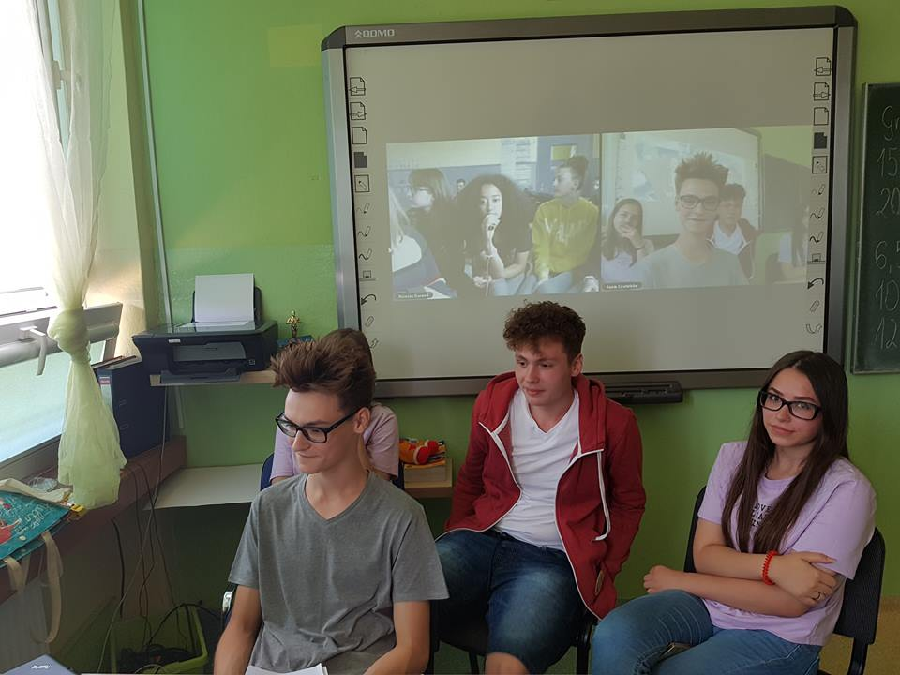
A video chat with France (eTwinning)

Slide 25
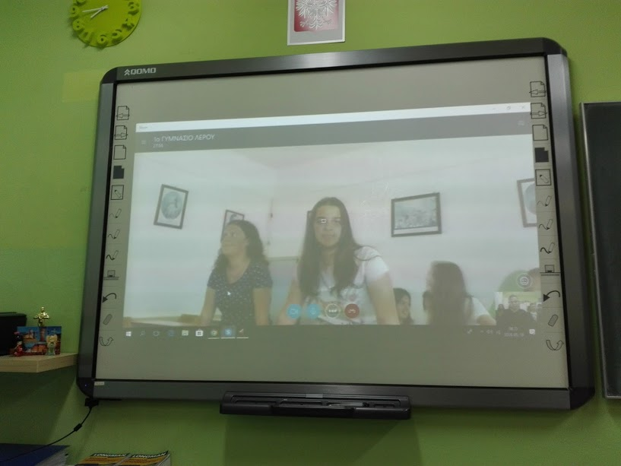
A video chat with Greece (eTwinning)

Slide 26
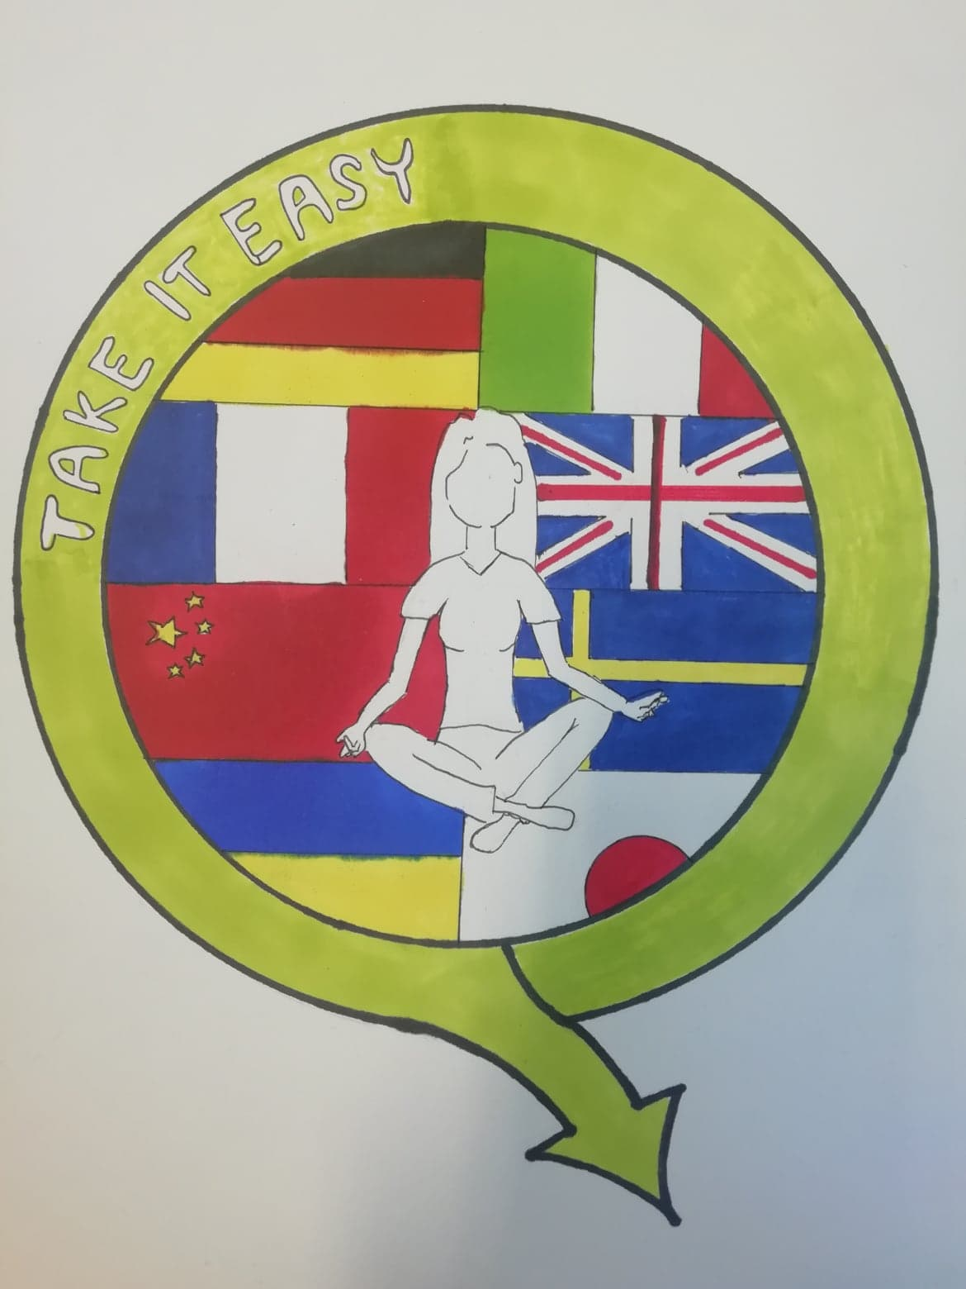
Erasmus+ projects:
Mobility of School Education Staff
2014-2015
New is coming
2016-2018
Step forward
2018-2020
Next step
2021-2023
Take it easy

Slide 27
General Education in Poland
Education in Poland is divided into 4 stages of learning:
Nursery/Kindergarten- optional stage
Stage I primary school (classes I-III, students aged 7-10)
Stage II primary school (classes IV- VIII, students aged 10-15)
Stage III, high school (classes I-IV, students aged 15-19)
or technical school (classes I-V, students aged 15-20)
or vocational school (classes I-III, students aged 15-18)

Slide 28
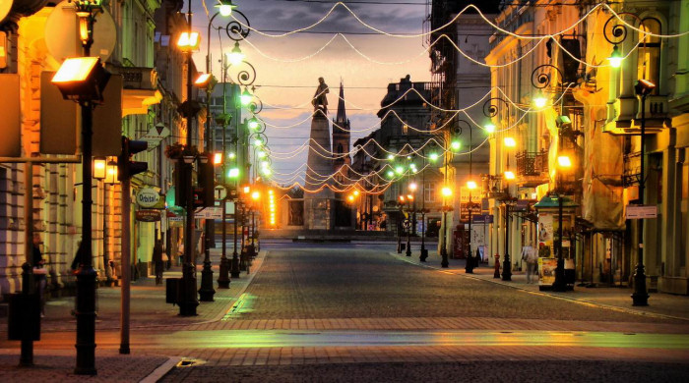
Łódź

Slide 29


Łódź is the third largest city in Poland and it is located in the central part of the country, around 20 kilometres from Stryków.
Coat of arms
Flag

Slide 30

FIVE TOP PLACES IN ŁODŹ ;)

Slide 31
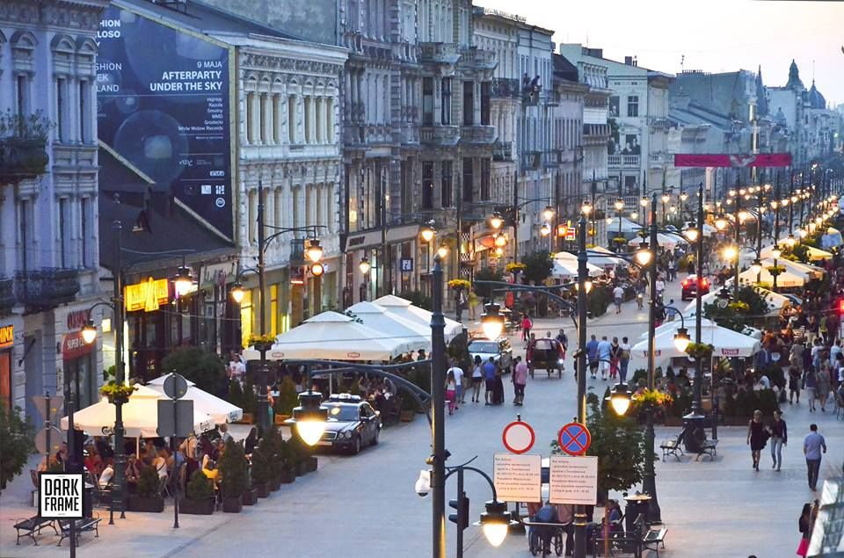
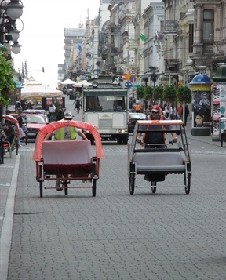
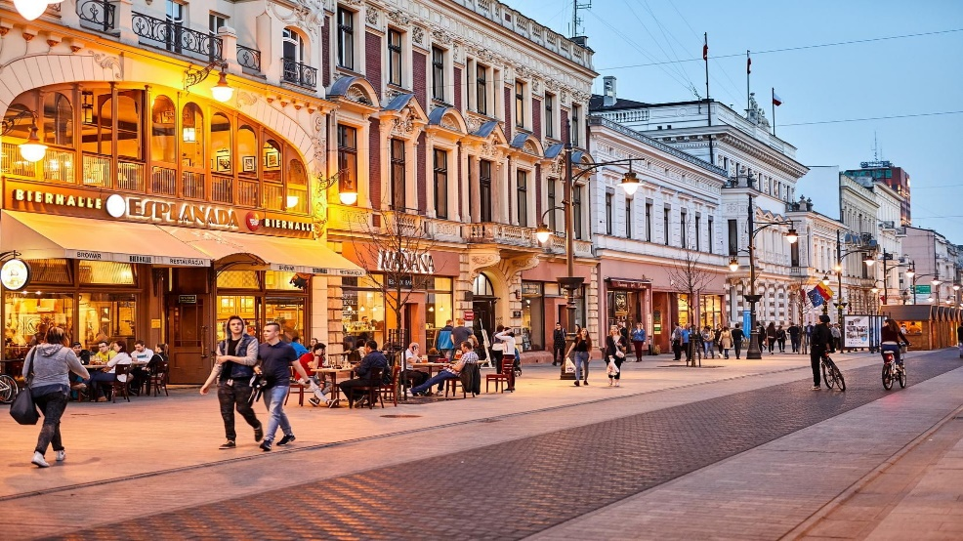
Piotrkowska Street- the longest street in Poland, about 4 kilometres long

Slide 32
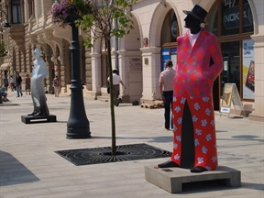
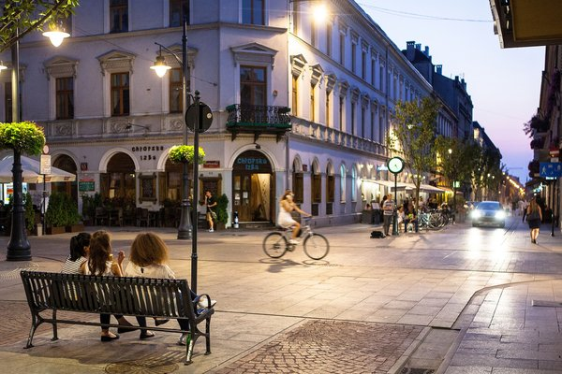


Slide 33

Manufaktura- an arts centre, shopping mall, and leisure complex

Slide 34




Slide 35


Izrael Poznański Palace

Slide 36


The Grand Theatre- the second largest opera house in Poland

Slide 37



Film Museum

Slide 38

Thank you !

Slide 39
Sources:
https://images.app.goo.gl/FNqn5aQi8wwJT9SR7
https://images.app.goo.gl/jB1mUBsphEQnFXNi9
https://images.app.goo.gl/9fAYHCrRcmTbs9CJ8
https://www.google.com/search?q=landmarks+lodz&sxsrf=ALiCzsYLzYrmOzTATd2vTBLs4pfQAivl4w:1657191234194&source=lnms&tbm=isch&sa=X&ved=2ahUKEwj42tq2zub4AhUqi_0HHUQCBe8Q_AUoAnoECAIQBA&biw=1366&bih=625&dpr=1

